Slide 1


Real Time Seat Availability in Metro
TEAM CODE BRIGADE

Slide 2
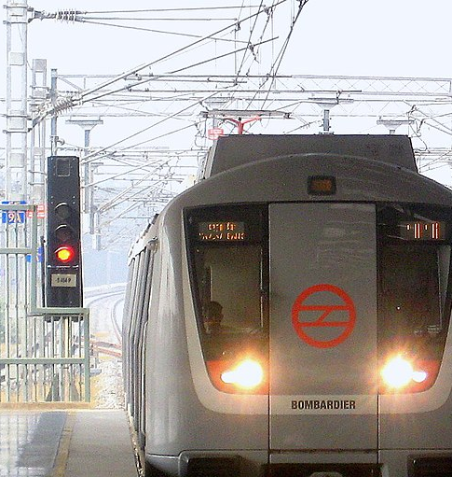
What is the First thing comes to your Mind on the Metro Platform ?
Where should I stand so I can have a seat?
Which bogie has more space? First, Last or Middle one,Or I have to stand in a cluster
This Photo by Unknown Author is licensed under CC BY-SA

Slide 3
Problem Statement
There have been a problem of havoc in the metro during entry and exit and many people try to enter in the same bogie.
Its sometime hard to predict which bogie is having more space to have seat and there is also a time constrain.
Public transport is a high prone area, particularly in metro cities, of the spread of infections like coronavirus, which we have seen recently.

Slide 4
Explanation
What if we can know the real time number of people space seats available in the boogie of upcoming Metro?
Wouldn’t it be great for people with disabilities, aged people, females? So that they can stand accordingly.
Won’t it ensures the safety in high times like direct pandemic?

Slide 5
Solution
We wish to provide the space/seats available inside the next upcoming metro.
The data we use i.e. the real time video will be provided by the Cameras already present in the metro when implemented in the real world.
Computer Vision will allow us to find the number of people inside the metro.

Slide 6
Data flow
ML Model:
To find the number of People in the Video
Display of information on Metro Platform Screen
Input:
Video from Camera inside Metro
Server to Process Data
Display of Data on Web Portal

Slide 7

Tech stack
OpenCV for AI vision
Flask for the integration of open cv with webserver.
Haarcascade Concept for data training.
HTML, CSS, Python & Java script for web designing and data manipulation.

Slide 8
Future Roadmap
Large scale implementation can be supported further with IOT devices
Inclusiveness of all metro coaches in all lines
Model can be utilised to view the occupancy in cluster buses
Model can be leveraged to view the social distancing during pandemic

Slide 9


Prospects of Metro Suvidha
01
Motive | Solution | Features
Why METRO SUVIDHA?
Impacts
02
Technicalities
Working of METRO SUVIDHA
Features
AI Model
03
Roles
SMART Transportation
Roles and Responsibility

Slide 10

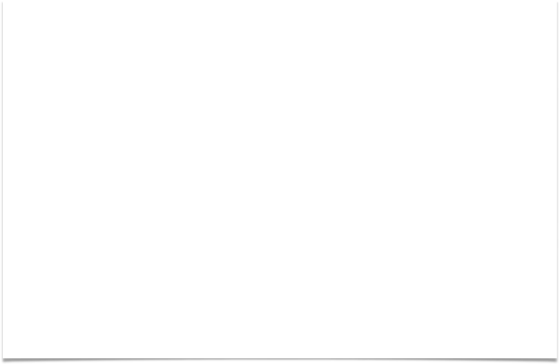
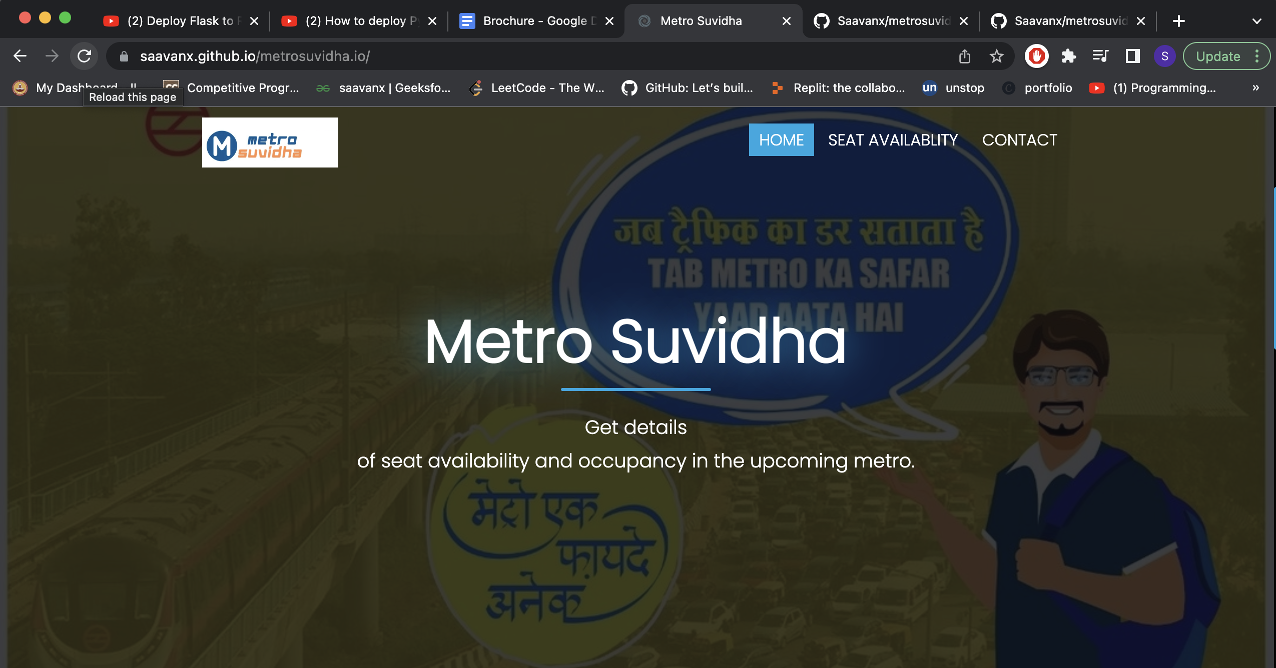

Slide 11
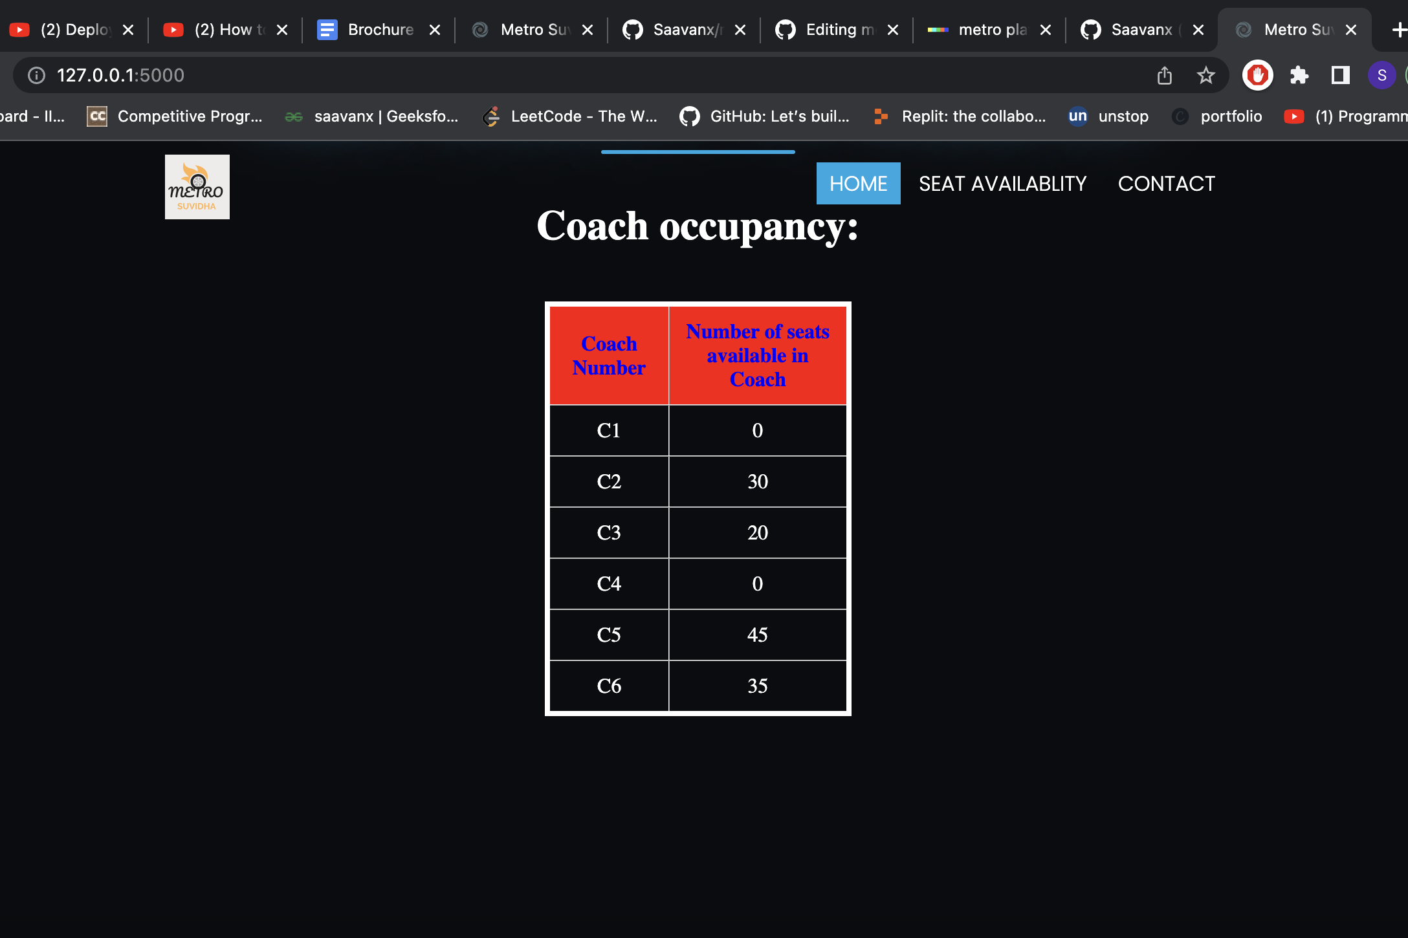

Slide 12
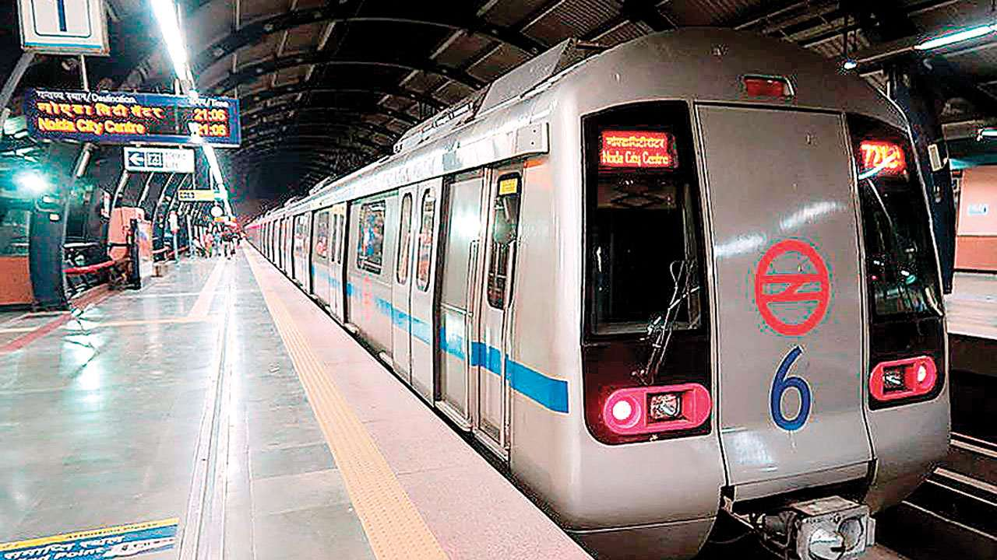
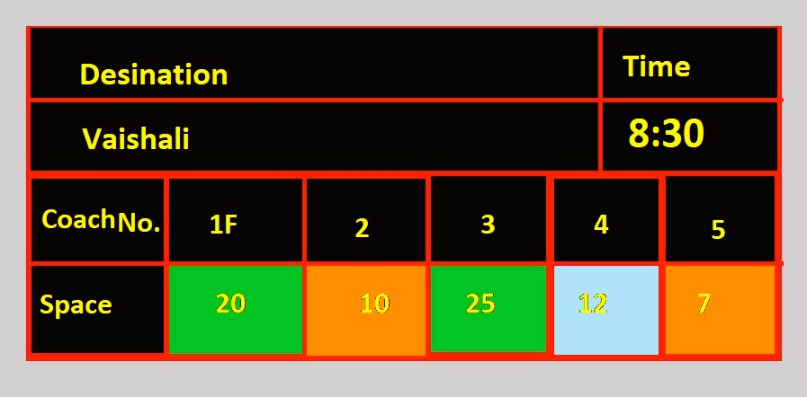
Future Prospects in Real World

Slide 13
Technology Stack Used
Team Roles
Abhishek SINGH
Team Leader & Back-end Code Integrator
Atharv Chaturvedi
ML / Presentation desigenator
Nitesh Kumar
Flask/Frontend development
Abhinav Kumar
Tech Stack Innovation/Modelling
OpenCV for AI vision.
Flask for the integration of Backend.
HTML,CSS,JAVA SCRIPT
PYTHON
NUMPY MODULE
Deployment-GitHUB
Regards,
Team CODE BRIGADE

